Slide 1
Sprint 1

Slide 2
Group member:
Li Minhao, id:minhaol
Ziyu Gu, id:ziyug

Slide 3
The product backlog
1, Calendar(home page):
Activity schedules for future events(allow users to add new schedule or remove finished assignments).
2, Notification( information box or alert function):
Server could send remind message(before the planned event) and certification message(after events) to keep track of users’ progress.
3, Real Activity History Display(history page):
Create a program working on the computer monitoring the computer activity, get data of software usage and web connection(by get info from socket), then send the info to the server.
Display a dashboard to show different kinds of chart of history time management (expected and actual).
4, Activity view(activity page):
Apply a matching algorithm (on database) to show other users who potentially have the same hobbies or related events arranged as you.
Adding the attribute--popularity to a user’s scheduling event. User can set it to be public and allow others to attend it.

Slide 4
First Sprint Backlog
1, Calendar(home page):
Activity schedules for future events(allow users to add new schedule or remove finished assignments).
Still working...

Slide 5
Data model implementation
bio_text
profile
picture
User
name
activity
time
type
computer_activity
popularity
name
time
type

Slide 6
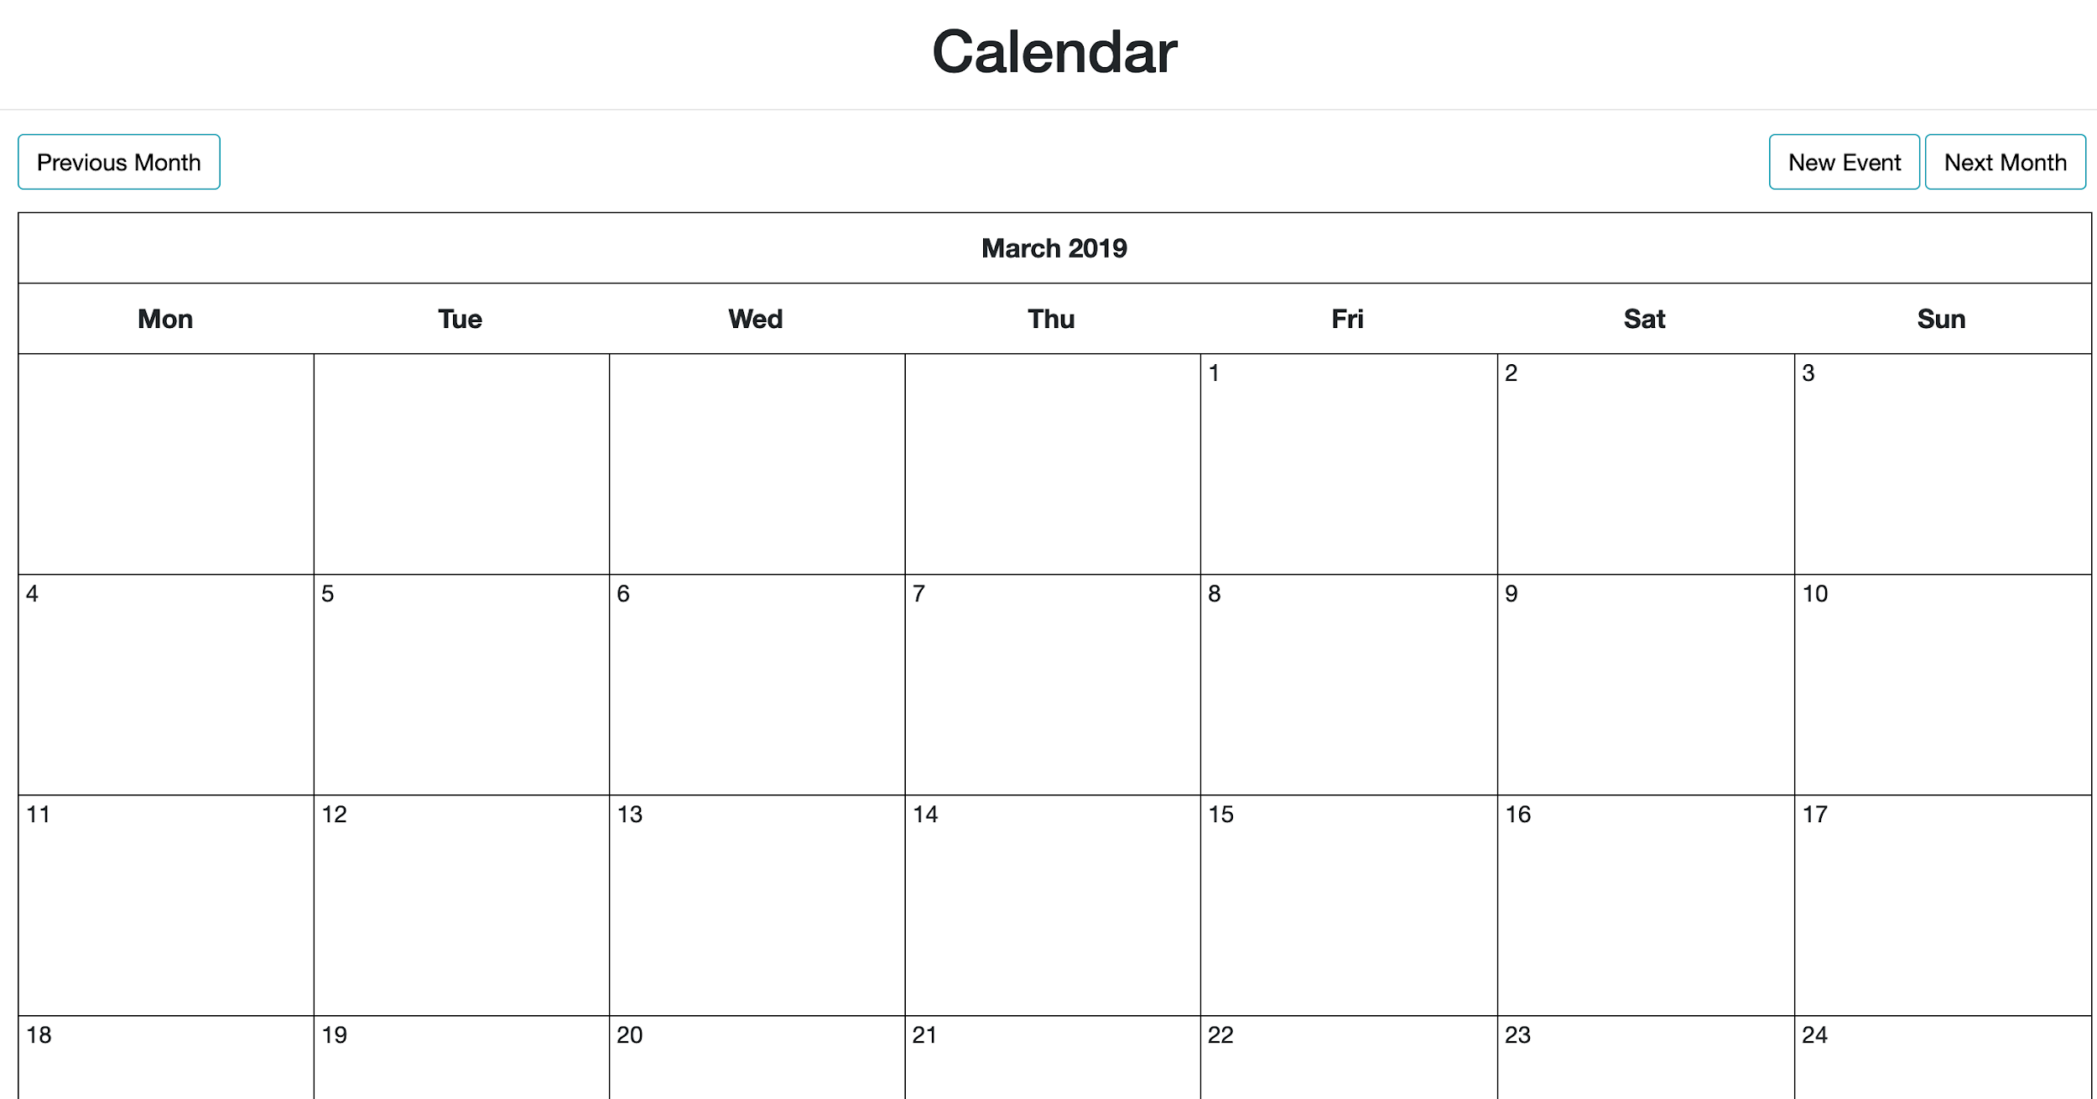
HTML mockup
Frontend demo

Slide 7
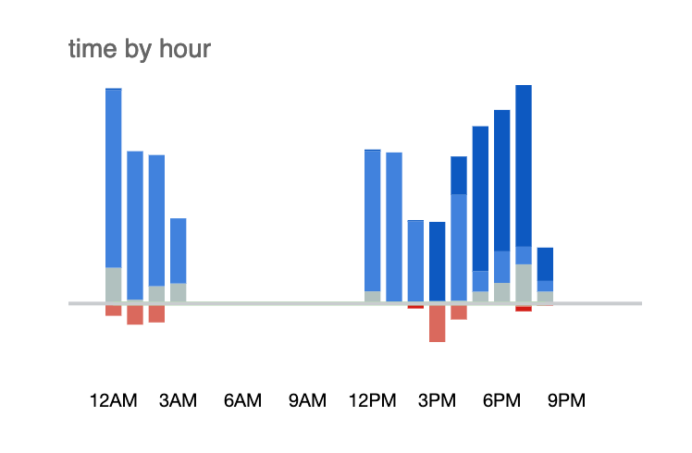
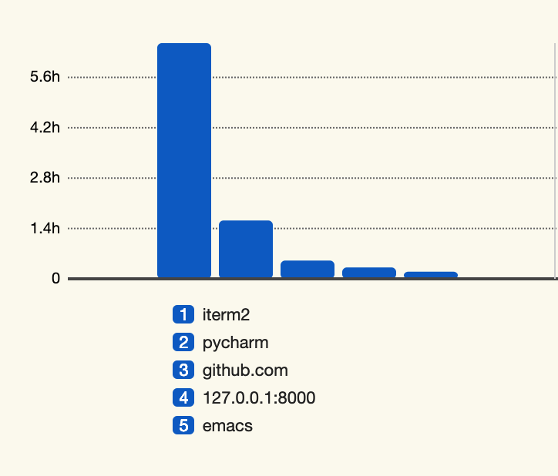
HTML mockup

Slide 8
Additional include
● a short background of what your project is and who is working on it
We want to develop a app allowing user to make a new schedule and review the analysis of their past schedule. The basic function is to allow user to add plans in a calendar. Our app will provide comparison between what they expected and what they really did. Then adding some extra functions potentially make it more popular and connected user on this app.
● your original goals for the just-completed sprint,
Calendar page
● what you have completed during the sprint,
Part of the calendar page.
● a brief description of your goals for the next (upcoming) sprint.
Finish the calendar page and notification function. Also work on some functions in activity page and history page.

